Slide 1

Title: Road Quality Measurement from High Resolution Satellite Images for National Highways of Bangladesh
CSE 4250: Project and Thesis - II Defense
Submitted By
Abrar Jahin 160204029
Anas Sikder 160204021
Dipesh Shome 160204045
Supervisor
Prof. Dr. Kazi A Kalpoma
July 10, 2021

Slide 2
Outline
Introduction
Motivation
Objectives
Backgrounds and Statistics
Literature review
Proposed Methodology For Road Quality Measurements
Approach_1: Convolutional Neural Network.
Approach_2: Transfer Learning Approach.
Experimental Results
Evaluation
Web Based prediction System.
Limitations
Conclusion and Future work
References

Slide 3
Introduction

Slide 4
Introduction
Roads are the bloodline of a country.
Establishes connection between important places, roads, ports, and capital.
Traditional road quality monitoring systems are time-consuming, laborious, and manual.
Roads and Highway Department of Bangladesh spent 35838.7 million BDT for the year 2018-19 and the predicted expenditure for 2019-20 is 16793.07 million BDT for the overall maintenance of highway and regional roads ^{[1]}.
Design some extended automated system where road quality can be predicted from satellite images without physical visit.
Classification of road quality using High Resolution Satellite Images is our primary task.

Slide 5
Motivation
No work using road satellite images
Efficient road maintenance is necessary.
Knowing the road quality without physical visit.
Reduce road maintenance cost is possible by using satellite images.
Optimal budget

Slide 6
Objectives
To build a road quality measurement automated model for Bangladesh.
To classify the national highway of Bangladesh from IRI and high-resolution satellite images.
Take four major highways: Dhaka - Chittagong - Teknaf (N1) , Dhaka - Khulna (N4), Dhaka - Rajshahi (N6), Dhaka - Mymensingh (N7) National roads to create standard train-test dataset
Take one additional road Dhaka - Sylhet (N2) for evaluating our methods.
Develop an efficient and effective method to predict road quality based solely on observing satellite images.
Finally, make a web based prediction system.

Slide 7
Backgrounds and Statistics

Slide 8
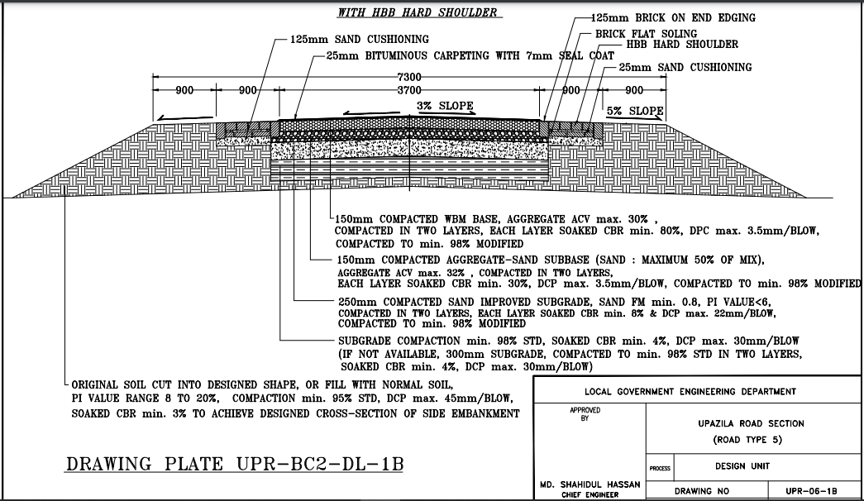
Conventional Design of Bangladesh Highways^{[8]}

Slide 9
Road Materials of Bangladesh^{[8]}
In our country roads of the national highway that are made of
25 mm Bituminous carpet with 7 mm seal coat
125mm sand cushioning
150 mm compacted WBM base aggregate acv max 30%
150 mm compacted aggregate-sand subbase
250 mm compacted sand improved subgrade

Slide 10
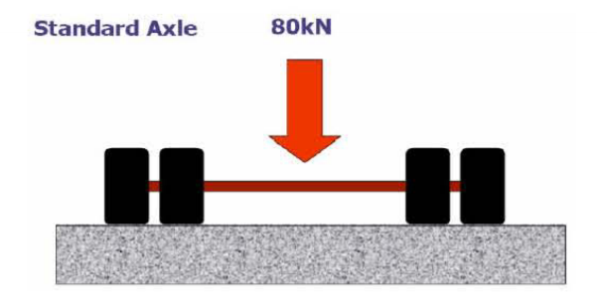
National Highway Roads Life Cycle
The life cycle concept in road management is aimed to discover the overall costs, long-term performance and other impacts of road projects which extend on the entire service life of the road^{[7]}.
Design Life (Million ESA’s) | Expected Design Life (Years)
1.6 | 10
5.0 | 20
6.5 | 20
*ESA: A Equivalent Standard Axle is defined as a Dual Tyred Single Axle transmitting a load of 80kN (or 8.2 tonne) to pavement^{[7]}

Slide 11
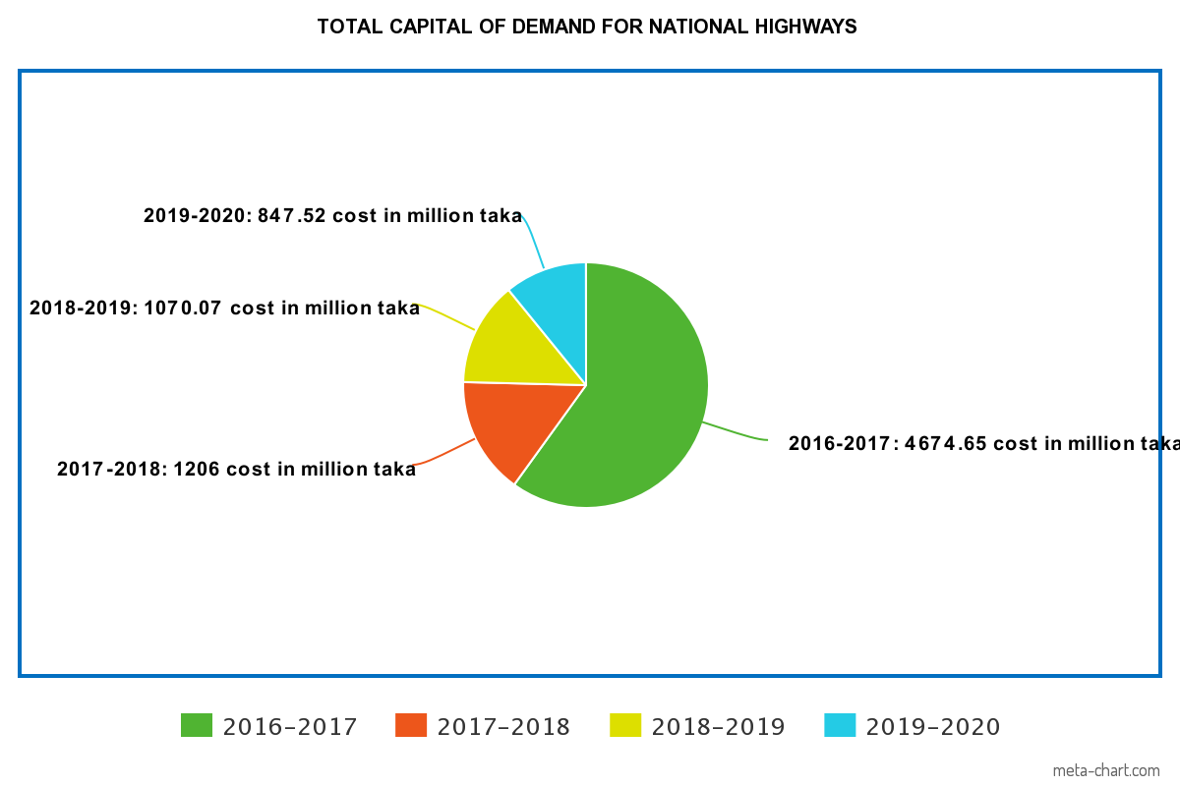
National Highway Roads Costing of Last four Years^{[7]}

Slide 12
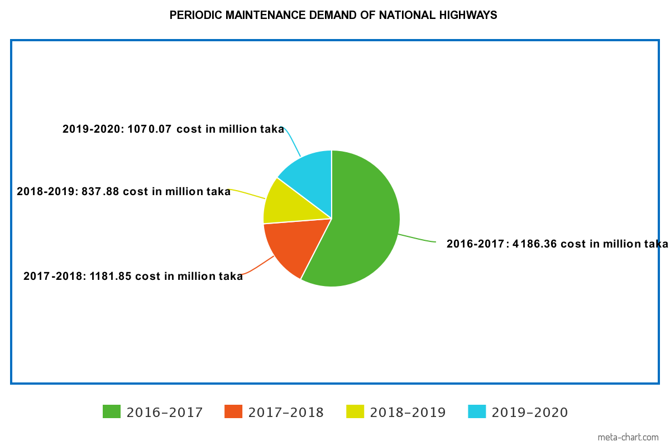
National Highway Roads Costing of Last four Years^{[7]}

Slide 13
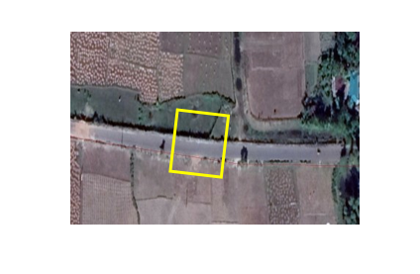
Road Quality Measurement
Roads and Highways Department (RHD) is a Bangladeshi state Department responsible for construction and maintenance of roads and highways in Bangladesh.
Roads quality are classified based on the International Roughness Index (IRI).
IRI is a function of suspension movement rate and car speed and strongly correlates with ride quality and vibration level.
IRI obtained from measured longitudinal road profiles.
The value of IRI index differs from country to country.
In Bangladesh, IRI is measured every 100m of road after one or two years.

Slide 14
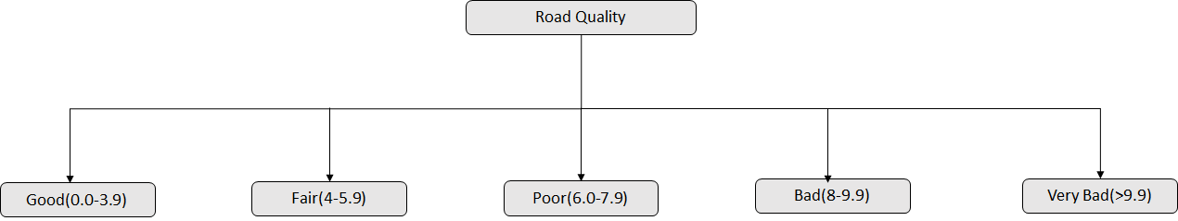
Roads Quality Classification
.
In Bangladesh, our roads are classified into five categories according to the IRI value

Slide 15
Literature Review

Slide 16
Literature Review
Literature Review--Cadamuro et al. ^{[2]} | 2. Literature Review--Dorj et al. ^{[3]} | 3. Literature Review--Rashmi et al. ^{[4]}
Developed a model for monitoring the quality of road infrastructure Using satellite imagery for the country of Kenya. | Their objective was to design a lane detection technique. To control the self-driving car. | This is a survey paper based on various edge detection techniques. canny edge detection perform better for adaptive nature.
Used two set of data to make of datasets: IRI and corresponding satellite images. Classify images into two classes binary and five class. Split the dataset into 70:30 as train and test set. Used image patch size: 64*64,224*224 Followed transfer learning from pre-trained models-Alexnet, VGG, Squeezenet. Standard test set: Binary-88% , 5 category- 73%. Held-out test set: Binary-79% , 5 category- 52%. | They used top view image transformation approach. Transformed image divided into two sections one is near and far section. Near section: Hough-line for st. line road Far section: combination of parabolic approach and the least square method for curve line. With their approach, they design a more robust Advanced Driving Assistant Systems(ADAS). | Less sensitive to noise and uses Gaussian filter to remove noise. Canny detector uses the ‘hysteresis’ technique. two threshold values to overcome the streaking problem. For good localization, canny edge provides edge gradient orientation.
Followed this model for our task | Learned lane detection. For straight and curve roads. | Learned edge detection

Slide 17
Proposed Model for Road Quality Measurement

Slide 18
Workflow of the Model
Complete workflow divided into eight steps
Data Acquisition
Dataset Creation
Road Extraction
Train-test Split
Feature Extraction
Web Based Prediction System
Predict Road Quality Classes
Classification

Slide 19
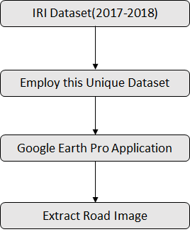
Data Acquisition

Slide 20
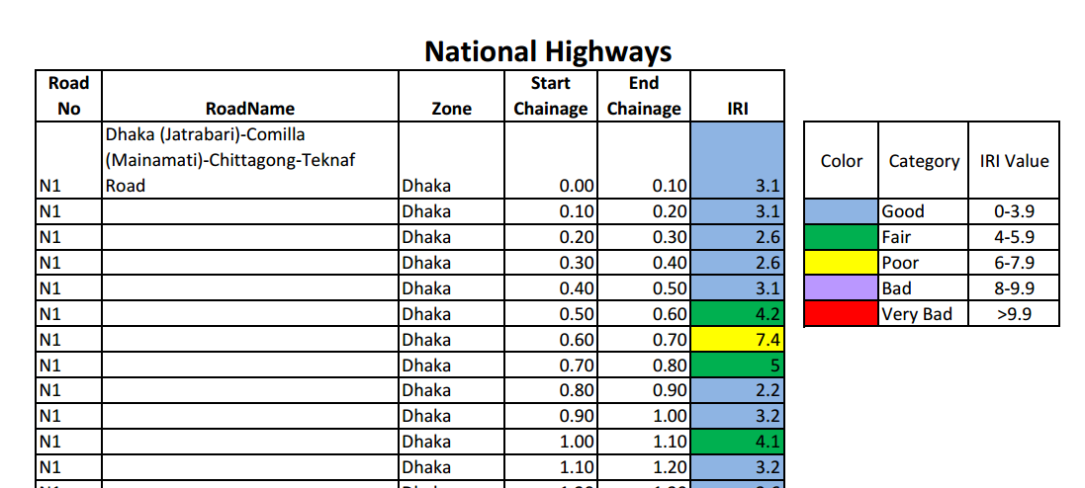
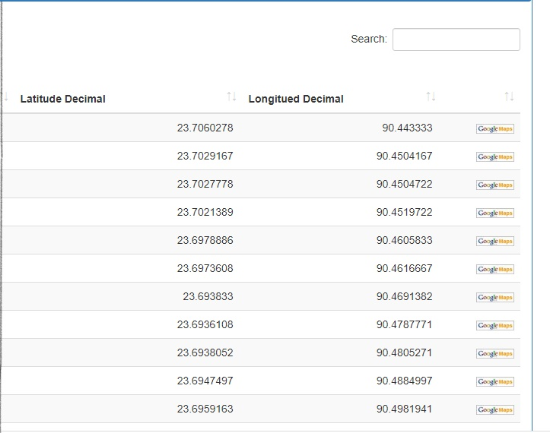
IRI Dataset
We collected road quality measurement (IRI) for the year 2017-2018 from Roads and Highways Department of Bangladesh.Road quality is measured every 100-meter interval of road.
Fig: IRI data collected from RHD

Slide 21
IRI Dataset
The IRI dataset is consists of several columns. From that, we consider only four following columns.
Road’s name
Road’s Start Chainage (latitude, longitude)
Road’s End Chainage (latitude, longitude)
Road’s Class.

Slide 22
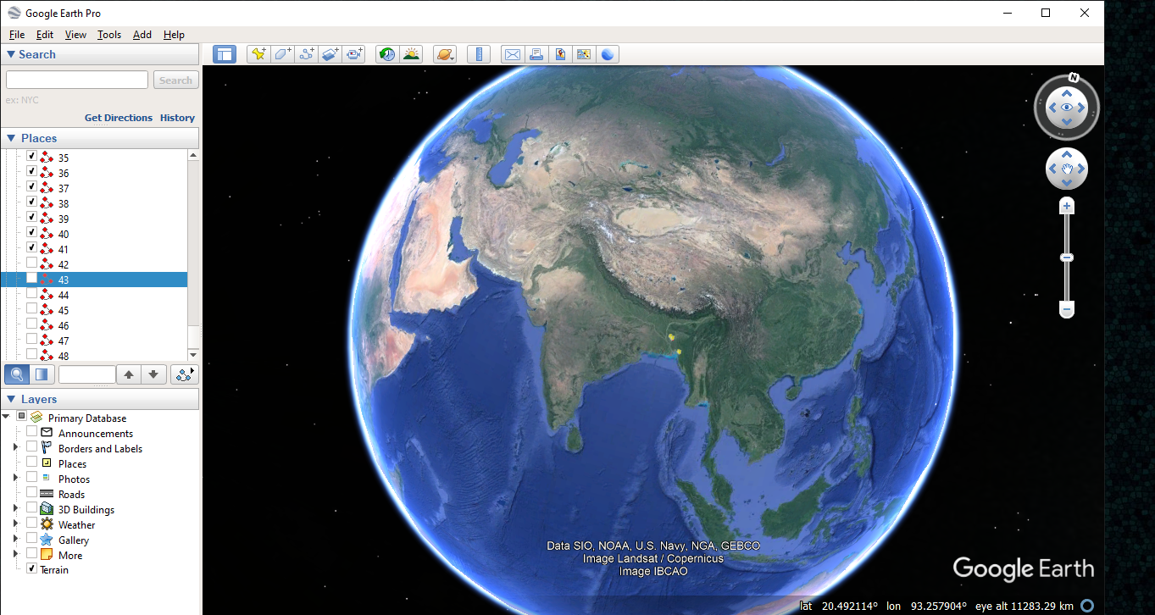
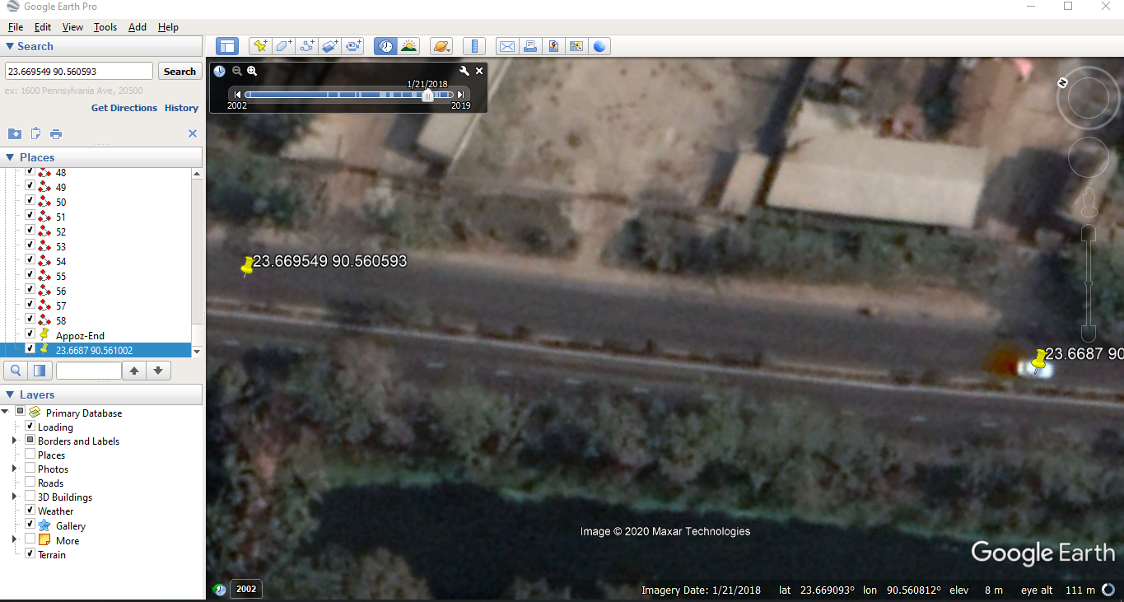
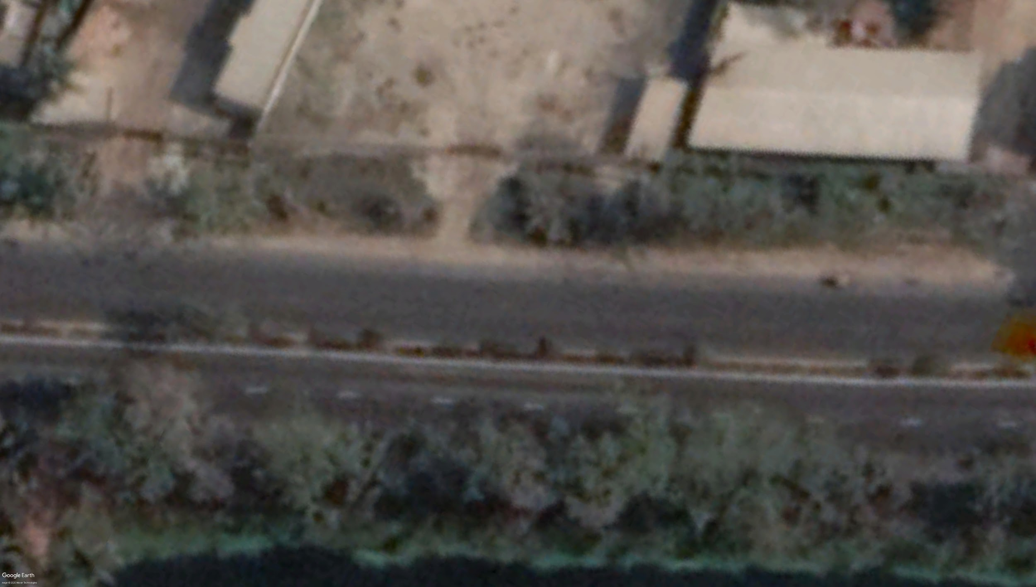
Google Earth Pro Application
We use google earth data (Google Earth Pro application) to collect satellite images.
First, we set the latitude and longitude values for each 100 meter of road. After that, we extracted each 100m corresponding satellite images and label it.
a) setting latitude and Longitude values
b) extract 100 meter of road image

Slide 23
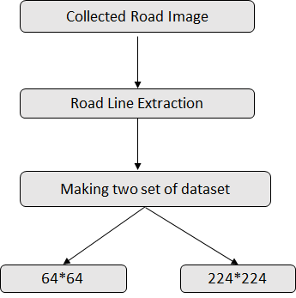
Dataset Creation

Slide 24
Image Collection
We use Four major National Roads of Bangladesh for creating dataset. We called it ‘standard train-test’ set
N1(Dhaka-Chittagong-Teknaf),
N4(Dhaka-Mymensingh),
N6(Dhaka-Rajshahi)
N7(Dhaka-khulna)
We took one additional 50 kilometers of National Road for testing purpose to evaluate our methods.. We named it held-out(unknown) test set
N2(Dhaka - Sylhet)

Slide 25
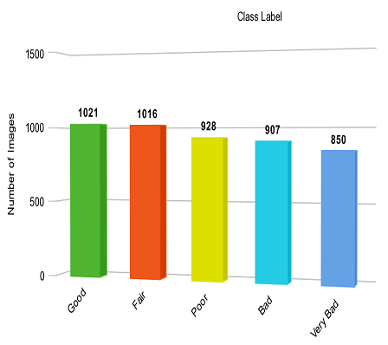
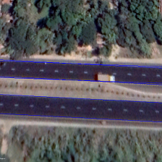

Image Collection
64*64 224*224
Total collected 4460 road satellite images.
The images we collected is simple RGB images
We used two different set of dataset for experiment.
One image can consider as 64*64*3 and 224*224*3 array.

Slide 26
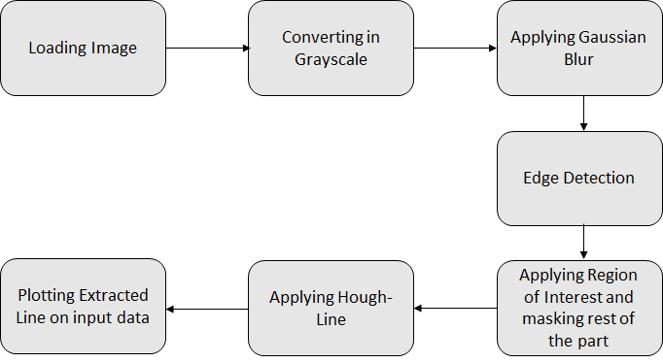
Image Processing: Road extraction

Slide 27

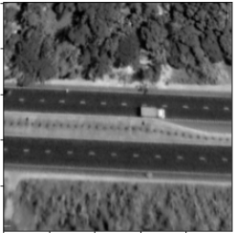
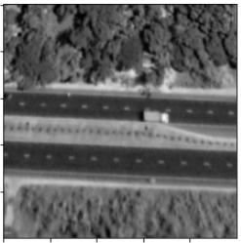
Road Extraction Sample Output
Step1: Loading Image
Step2: Converting into Grayscale
Step 3: Applying Gaussian Blur

Slide 28
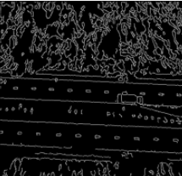
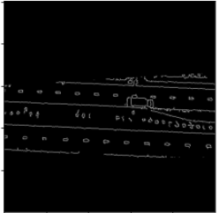
Road Extraction Sample Output
Step 5: Applying ROI and masking rest of the image
Step3: Gaussian blurred image
Step 4: Edge Detection

Slide 29
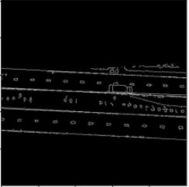

Road Extraction Sample Output
Step7: Plotting Extracted line in input data
Step5: Masked Image
Step6: Applying HoughLine

Slide 30
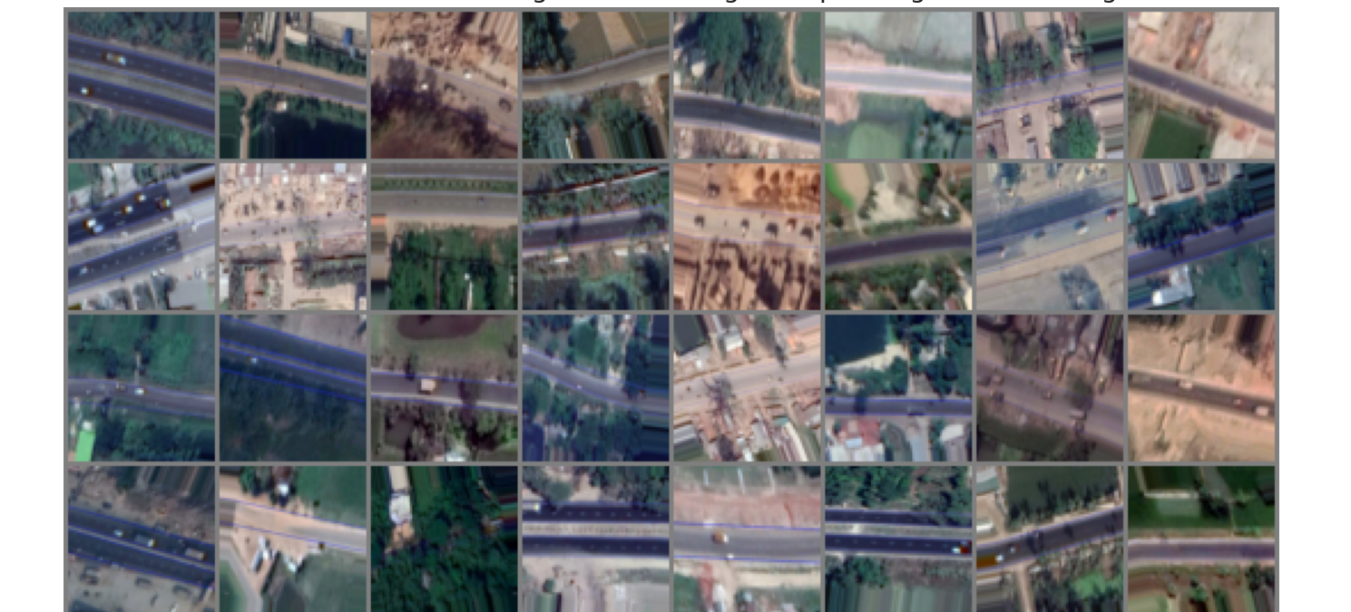
Snapshot of Dataset

Slide 31
Experiments

Slide 32
Experiments
In our First approach, we applied three layer deep convolutional neural network. We named it RoadNet model.
In second approach, we followed Transfer Learning approach from pretrained network. We trained on more than ten Deep Learning models: VGG11, VGG16, AlexNet, DenseNet, MobileNet, MnasNet, ResNet50, ResNext, InceptionV3, Inception-Resnet, SqueezeNet.

Slide 33
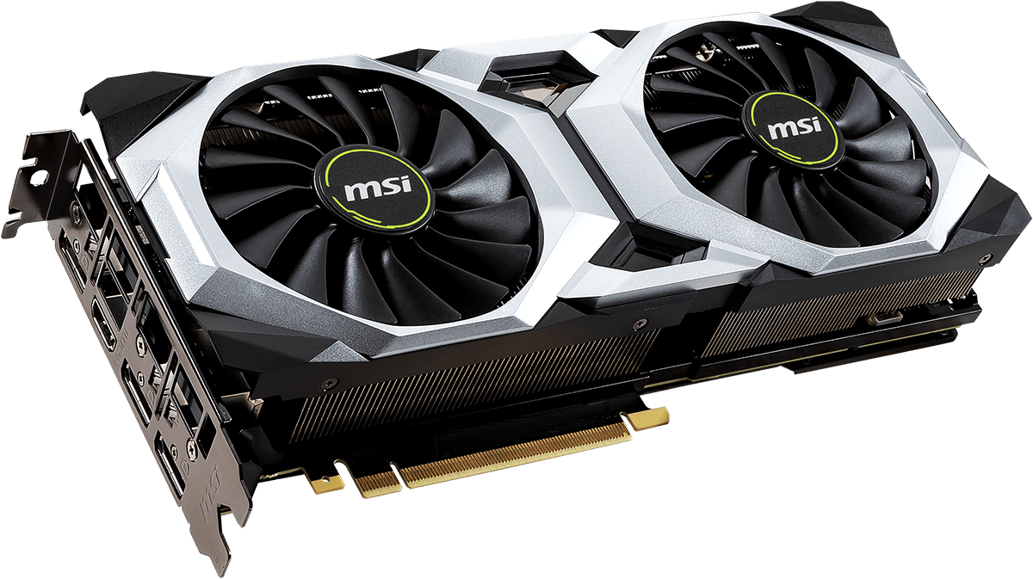
Experimental Setup
Hardware Requirement:
Ram 16GB
CPU intel core i7
GPU Nvidia RTX 2060
Software Requirement:
Colab
PyTorch
TensorFlow 2.0
Keras API
Fig: RTX 2060 GPU

Slide 34
Splitting Ratio
We split the entire ‘Standard dataset’ with proportion to 70%: 30%, 80%: 20%, and 60%: 40% where we randomly assigned the data into train and test set.
 | Training set | Test set
60:40 | 2664 | 1804
70:30 | 3130 | 1330
80:20 | 3547 | 913

Slide 35
Data Augmentation
We generated seven more images from one images. We applied this augmentation process for our training purpose. We remain unchanged the testing set. We used 20% from training set as validation set.The augmentation is followed by
Rotation
Width Shift Range
Height Shift Range
Fill mode
Shear range
Zooming
Brightness
Horizontal Flip
 | Training set | Test set
60:40 | 18595 | 1804
70:30 | 21915 | 1330
80:20 | 24832 | 913
Table: Train and test set after augmentation
Notes:
'Shear' means that the image will be distorted along an axis, mostly to create or rectify the perception angles

Slide 36
Overview of Training, Validation and Testing Set
 | Training set | Validation set | Test set
60:40 | 14874 | 3721 | 1804
70:30 | 17530 | 4385 | 1330
80:20 | 19864 | 4968 | 913
Held-out Test set (Different Road )
522

Slide 37
Evaluation Metrics
Accuracy: Ratio of the correct predicted images and the total number of images.
Training Accuracy: The accuracy of a model on examples it is constructed on.
Testing Accuracy: The accuracy of a model on examples is not seen.
Confusion Matrix: The Confusion matrix is one of the most intuitive metrics used to find the correctness and accuracy of the model. It is used for Classification problem where the output can be of two or more types of classes
Precision: Precision can be defined as the ratio of correctly predicted positive observations to the total predicted positive observations
Recall: Recall is the ratio of correctly predicted positive observations to the all observations in actual class

Slide 38
Approach_1: Proposed Convolutional Neural
Network (CNN): RoadNet

Slide 39
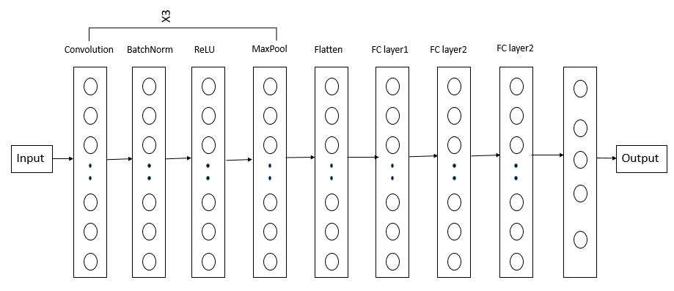
Proposed CNN(RoadNet) Architecture
Fig: Proposed Convolutional Neural Network(RoadNet) Architecture

Slide 40
Convolution Layer
The Beginning Layer.
Converting all the image into 64*64*3 homogenous dimension.
Convolutional kernel of 16 convolutional filters of size 5*5 with the support of 3 tensor channels.
Batch Normalization is used to standardize the inputs to network.
ReLU as Activation function.

Slide 41
Max Pooling Layer
Because of overfitting Max pooling layer was introduced.
Maxpooling2d for the model.
Runs on 8*8*64 dimension.
Pool size used (2,2)
Output: Pooled feature map.

Slide 42
Flatten Layer
Pooled feature map is work as the input.
Transform the whole matrix into a single column vector.
Fed to the neural network for processing.

Slide 43
Fully Connected Layer
Three fully connected layers were employed.
Obtained single vector goes as an input.
4096, 512,256 nodes in the hidden layer.
For better convergence ReLU and dropout function is used as an activation function after each fully connected layer.

Slide 44
Hyperparameter Settings
Stage
Hyper-parameter | Value
Bias | Zeros
Weights | uniform
Learning Rate | 0.001
Optimizer | Adam
Gamma | 0.1
Momentum | 0.1
Step_size | 7
Decay | 0.0
Loss_function | cross_entropy
Batch_size | 32,64
Epochs | 30
Initialization
Training
Table: Hyper-parameter settings of RoadNet model(custom cnn)

Slide 45
Experimental Results of CNN: RoadNet

Slide 46
Training: CNN(RoadNet)
Ratio
60:40
70:30
80:20
Batch
64
32
64
32
64
32
Model Name
RoadNet(64*64)
Epochs | Training Time(sec) | Training Acc(%)
28 | 3120s | 91.28
30 | 3240s | 90.90
29 | 3060s | 86.73
30 | 3180s | 86.27
23 | 2852s | 90.01
30 | 3720s | 89.62
25 | 3712s | 87.79
30 | 3840s | 87.45
28 | 3128s | 90.59
30 | 4080s | 90.36
28 | 3864s | 86.57
30 | 4140s | 86.35
Table: Training accuracy of the proposed model based on batch size

Slide 47
Performance: CNN(RoadNet)
Model Name
RoadNet(64*64)
Batch Size | Standard Train-Test acc(%) Road: N1,N4,N6,N7 | Held-out acc(%) Road: N2
32 | 69 | 47
64 | 72 | 50
32 | 73 | 51
64 | 72 | 54
32 | 75 | 50
64 | 74 | 51
Ratio
60:40
70:30
80:20

Slide 48
Findings
Training accuracy and testing accuracy is comparatively low in CNN(RoadNet) Model.
Training from scratch takes long time and more epochs.
Transfer learning approach can be a good alternative to improve the accuracy.

Slide 49
Approach_2: Transfer Learning

Slide 50
Transfer Learning
Approach of transferring knowledge from one or more sources to improve the learning of target task.
Has the benefit of decreasing training time and resulting in lower error.
The recent progress in deep learning has facilitated transfer learning mainly because of two reasons:
1. Networks can be pre-trained on one domain and be tuned on another domain.
2. Network weight can be shared among different tasks.

Slide 51
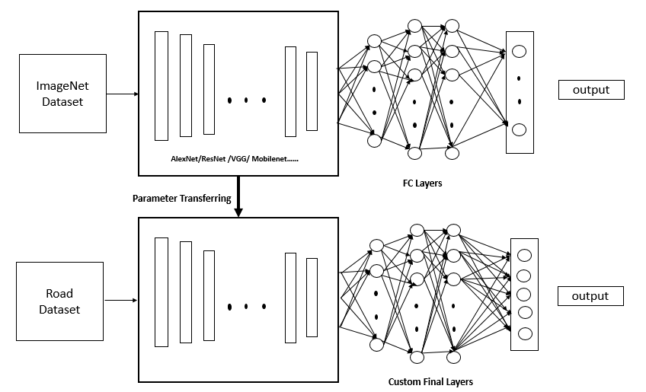
Proposed Transfer Learning Approach
Network is trained on large scale training dataset(ImageNet: 1.2 million, 1000 class).
Learned parameters passed to new domain.
Layers of trained model acted as feature extractor to extract features from Road Dataset..
Applied changes in last 2 to 4 layers for our classification task.
Fig: Proposed Transfer learning approach from pretrained network

Slide 52
Experimental Results of Transfer Learning

Slide 53
Performance: AlexNet
Best performance: Standard test set: 81% and Held-out test set: 55% in 70:30 split ratio
Model Name
AlexNet
Patch Size | Standard Train-Test accu(%) Road: N1,N4,N6,N7 | Held-out accu(% Road: N2
64 | 69 | 48
224 | 80 | 52
64 | 70 | 50
224 | 81 | 55
64 | 71 | 52
224 | 81 | 51
Ratio
60:40
70:30
80:20

Slide 54
Performance: DenseNet
Best performance: Standard test set: 83% and Held-out test set: 54% in 80:20 split ratio
Model Name
DenseNet
Patch Size | Standard Train-Test accu(%) Road: N1,N4,N6,N7 | Held-out accu(%) Road: N2
64 | 76 | 52
224 | 83 | 51
64 | 77 | 55
224 | 85 | 51
64 | 77 | 57
224 | 83 | 54
Ratio
60:40
70:30
80:20

Slide 55
Performance: MobileNet
Best performance: Standard test set: 83% and Held-out test set: 59% in 80:20 split ratio
Model Name
MobileNet
Ratio
60:40
70:30
80:20
Patch Size | Standard Train-Test accu(%) Road: N1,N4,N6,N7 | Held-out accu(%) Road: N2
64 | 76 | 52
224 | 83 | 55
64 | 77 | 54
224 | 82 | 49
64 | 78 | 58
224 | 83 | 59

Slide 56
Performance: MnasNet
Best performance: Standard test set: 81% and Held-out test set: 54% in 80:20 split ratio
Model Name
MnasNet
Patch Size | Standard Train-Test accu(%) Road: N1,N4,N6,N7 | Held-out accu(%) Road: N2
64 | 69 | 51
224 | 81 | 54
64 | 72 | 51
224 | 81 | 51
64 | 71 | 54
224 | 81 | 54
Ratio
60:40
70:30
80:20

Slide 57
Performance: InceptionV3
Best performance: Standard test set: 81% and Held-out test set: 55% in 80:20 split ratio
Model Name
InceptionV3
Patch Size | Standard Train-Test accu(%) Road: N1,N4,N6,N7 | Held-out accu(%) Road: N2
299 | 80 | 53
299 | 81 | 51
299 | 81 | 55
Ratio
60:40
70:30
80:20

Slide 58
Performance: Inception-ResNet
Best performance: Standard test set: 81% and Held-out test set: 55% in 60:40 split ratio
Model Name
Inception-ResNet
Ratio
60:40
70:30
80:20
Patch Size | Standard Train-Test accu(%) Road: N1,N4,N6,N7 | Held-out accu(%) Road: N2
299 | 81 | 55
299 | 79 | 48
299 | 82 | 52

Slide 59
Performance: ResNet 34
Best performance: Standard test set: 83% and Held-out test set: 58% in 80:20 split ratio
Model Name
ResNet 34
Patch Size | Standard Train-Test accu(%) Road: N1,N4,N6,N7 | Held-out accu(%) Road: N2
64 | 72 | 48
224 | 82 | 56
64 | 74 | 50
224 | 78 | 54
64 | 77 | 51
224 | 83 | 58
Ratio
60:40
70:30
80:20

Slide 60
Performance: ResNet50
Best performance: Standard test set: 85% and Held-out test set: 58% in 80:20 split ratio
Model Name
ResNet50
Patch Size | Standard Train-Test accu(%) Road: N1,N4,N6,N7 | Held-out accu(%) Road: N2
64 | 74 | 47
224 | 83 | 54
64 | 77 | 49
224 | 80 | 56
64 | 76 | 52
224 | 85 | 58
Ratio
60:40
70:30
80:20

Slide 61
Performance: ResNeXt
Best performance: Standard test set: 85% and Held-out test set: 53% in 80:20 split ratio
Model Name
ResNext
Patch Size | Standard Train-Test accu(%) Road: N1,N4,N6,N7 | Held-out accu(%) Road: N2
64 | 72 | 48
224 | 82 | 53
64 | 77 | 52
224 | 85 | 53
64 | 75 | 50
224 | 85 | 53
Ratio
60:40
70:30
80:20

Slide 62
Performance: SqueezeNet
Best performance: Standard test set: 80% and Held-out test set: 51% in 80:20 split ratio
Model Name
SqueezeNet
Ratio
60:40
70:30
80:20
Patch Size | Standard Train-Test accu(%) Road: N1,N4,N6,N7 | Held-out accu(%) Road: N2
64 | 72 | 46
224 | 79 | 50
64 | 73 | 44
224 | 78 | 48
64 | 73 | 48
224 | 80 | 51

Slide 63
Performance: VGG11
Best performance: Standard test set: 84% and Held-out test set: 57% in 80:20 split ratio
Model Name
Vgg11
Patch Size | Standard Train-Test accu(%) Road: N1,N4,N6,N7 | Held-out accu(%) Road: N2
64 | 76 | 52
224 | 82 | 54
64 | 76 | 51
224 | 83 | 52
64 | 76 | 52
224 | 84 | 57
Ratio
60:40
70:30
80:20

Slide 64
Performance: VGG16
Best performance: Standard test set: 82% and Held-out test set: 54% in 80:20 split ratio
Model Name
VGG16
Patch Size | Standard Train-Test accu(%) Road: N1,N4,N6,N7 | Held-out accu(%) Road: N2
64 | 76 | 50
224 | 81 | 54
64 | 78 | 51
224 | 82 | 52
64 | 77 | 55
224 | 82 | 54
Ratio
60:40
70:30
80:20

Slide 65
Evaluation

Slide 66
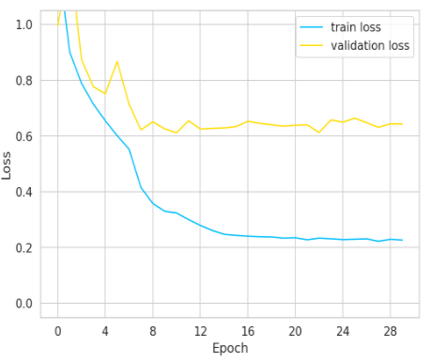
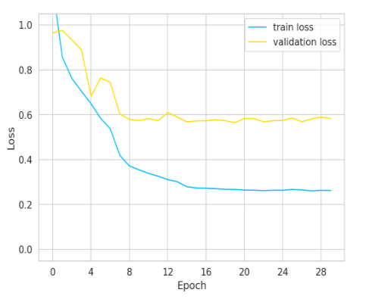
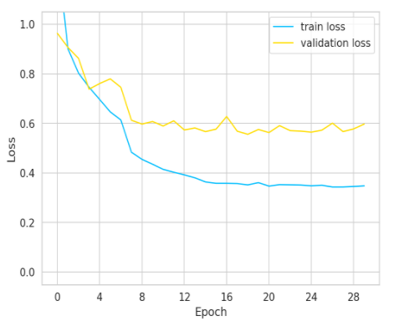
Model Evaluation: CNN(RoadNet)
Loss curve for CNN(RoadNet) model in different ratio.
60:40 ratio
70:30 ratio
80:20 ratio

Slide 67
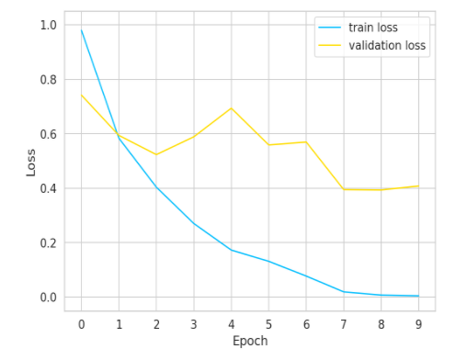
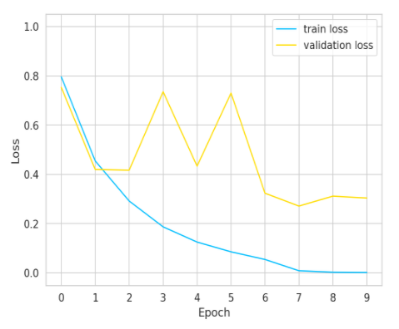
Model Evaluation: Transfer Learning Approach
Loss curve for 64*64 patch and 224*224 patch size in 60:40 ratio.
64*64 pixel patch
224*224 pixel patch

Slide 68
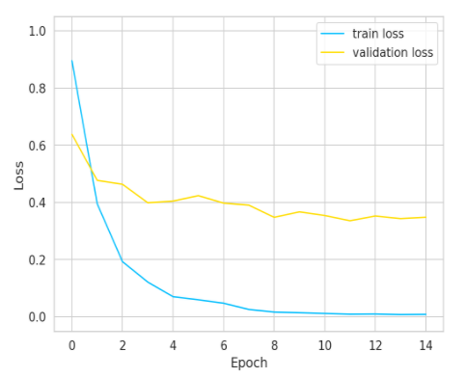
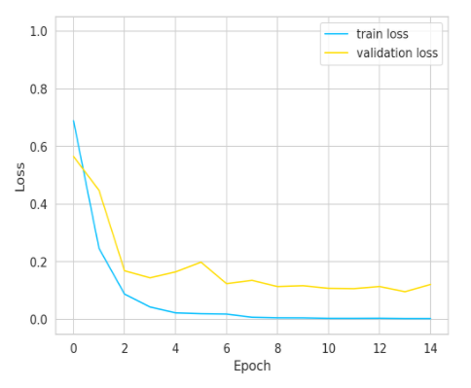
Model Evaluation: Transfer Learning Approach
Loss curve for 64*64 patch and 224*224 patch size in 70:30 ratio
64*64 pixel patch
224*224 pixel patch

Slide 69
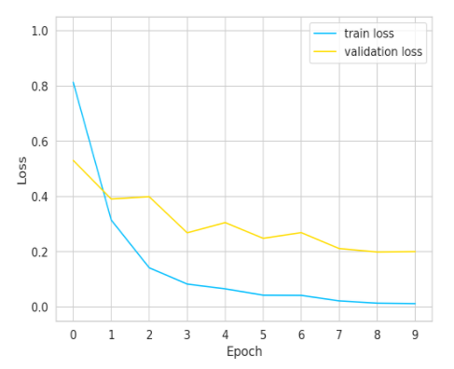
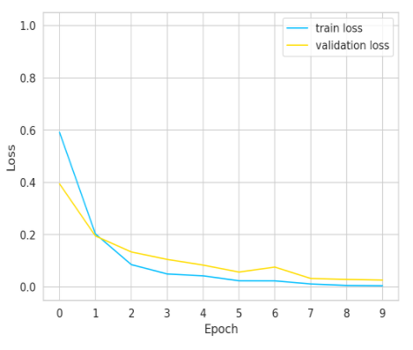
Model Evaluation: Transfer Learning Approach
Loss curve for 64*64 patch and 224*224 patch size in 80:20 ratio
64*64 pixel patch
224*224 pixel patch

Slide 70
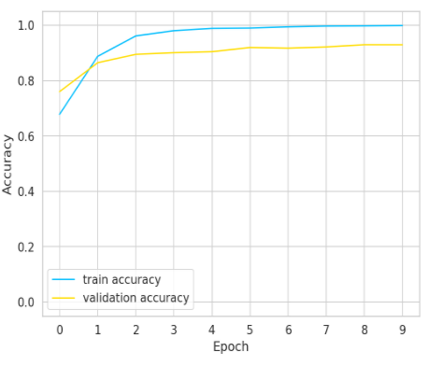
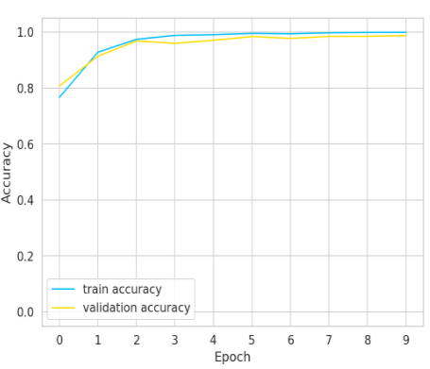
Model Evaluation: Transfer Learning Approach
Accuracy curve for 64*64 patch and 224*224 patch size in 80:20 ratio
64*64 pixel patch
224*224 pixel patch

Slide 71
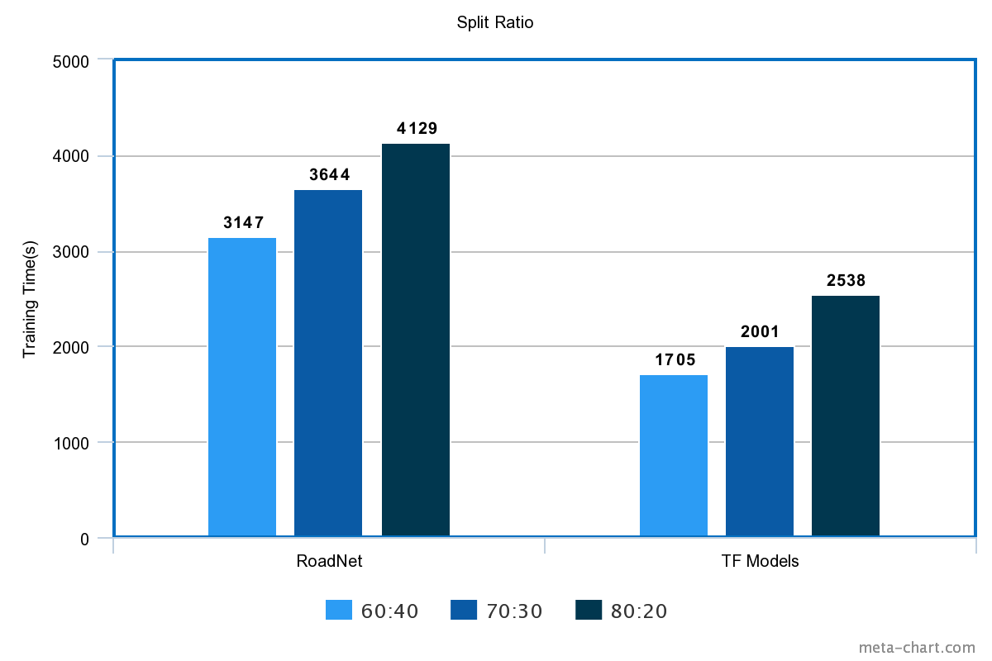
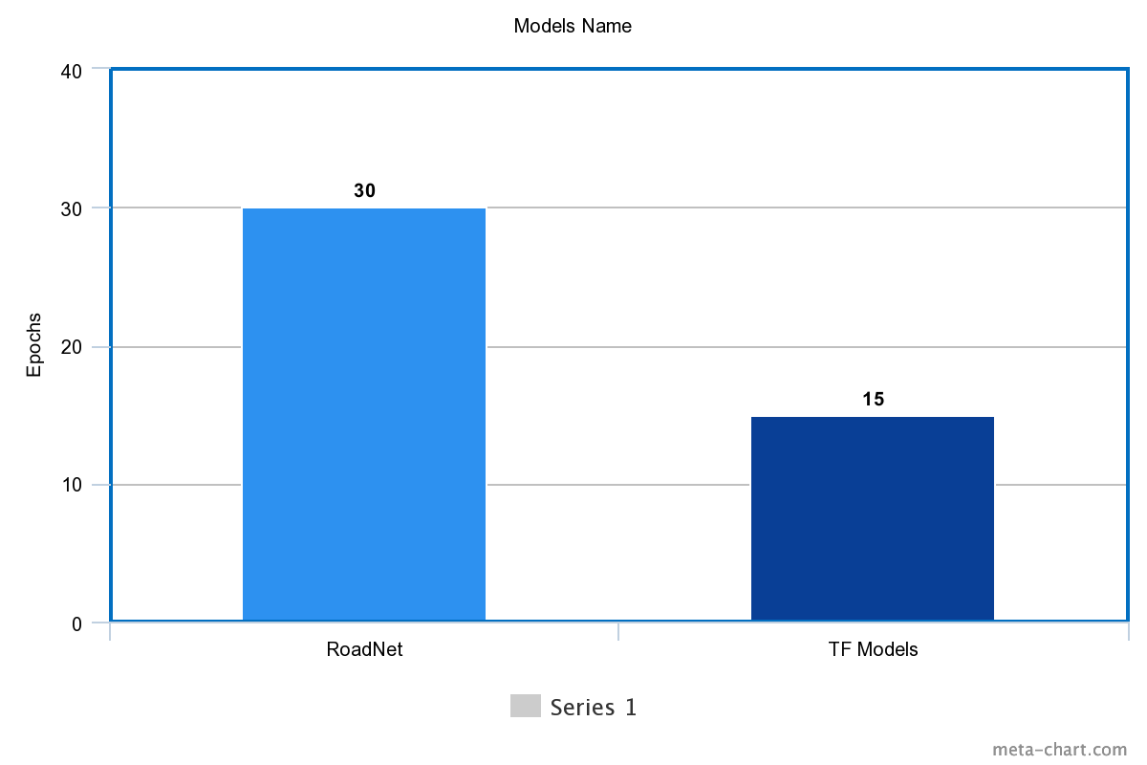
Model Evaluation: Training Time and Epochs
Fig: Epochs and Training time

Slide 72
Performance Comparison
Best performance: Standard test set: 85% and Held-out test set: 58% in 80:20 split ratio in ResNet50
Model Name | Split Ratio | Epoch | Standard train-test(%) Road: N1,N4,N6,N7 | Held-out (%) Road: N2
CNN(RoadNet) | 80:20(64) | 30 | 71 | 54
Vgg11 | 80:20(224) | 10 | 84 | 57
ResNet50 | 80:20(224) | 10 | 85 | 58
MobileNet | 80:20(224) | 10 | 83 | 59
Table; Performance comparison of Custom CNN model and Transfer learning models

Slide 73
Overview
In the standard train-test split, we found some variances in performance.
Perform moderate in predicting road quality classes.
Correlation between predictive accuracy and homogeneity of roads.
Decreased the predictive accuracy for held-out test.
Model face difficulties in predicting good and fair class.
Because maybe IRI values of good and fair class is too close.
Training from scratch takes long time and more epochs in CNN.
Transfer learning approach performed better than CNN(RoadNet) model comparing training time and accuracy.

Slide 74
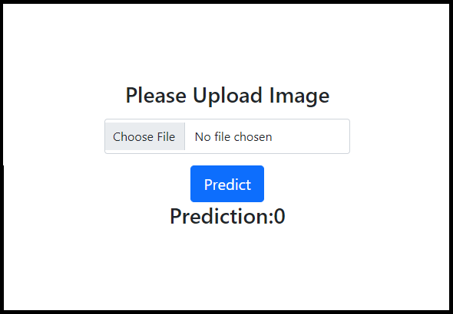
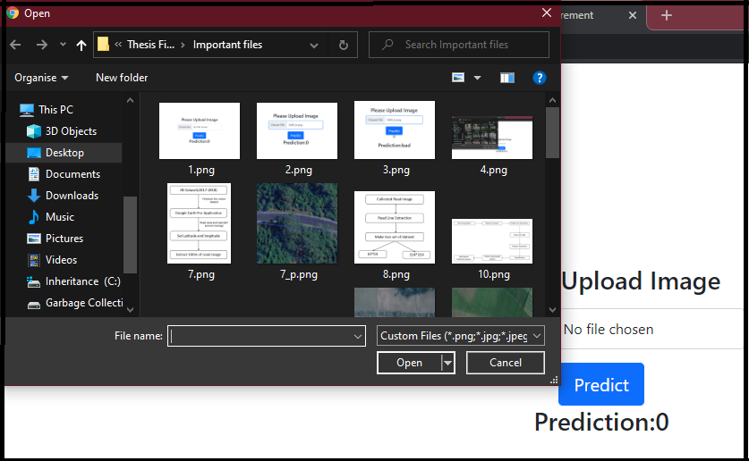
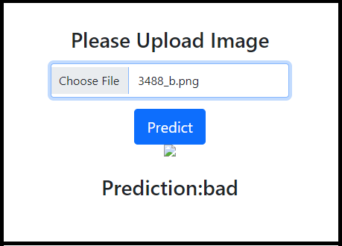
Web based prediction system
Prototype of web based prediction system using flask api.
One can upload road image and the system will generate a prediction from that image.
The prediction will be the one of road quality class labels
Fig: Uploading image and generating prediction

Slide 75
Limitations

Slide 76
Limitations
Our collected IRI dataset date range is between November 2017 to February 2018.
But Google Earth’s data is not continuously available for that specific date range.
This reduce our IRI dataset from 1511 kilometers to 498 kilometers which is 32% of our total National highways.

Slide 77
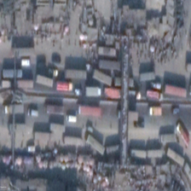
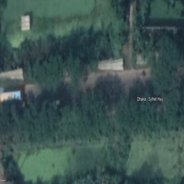
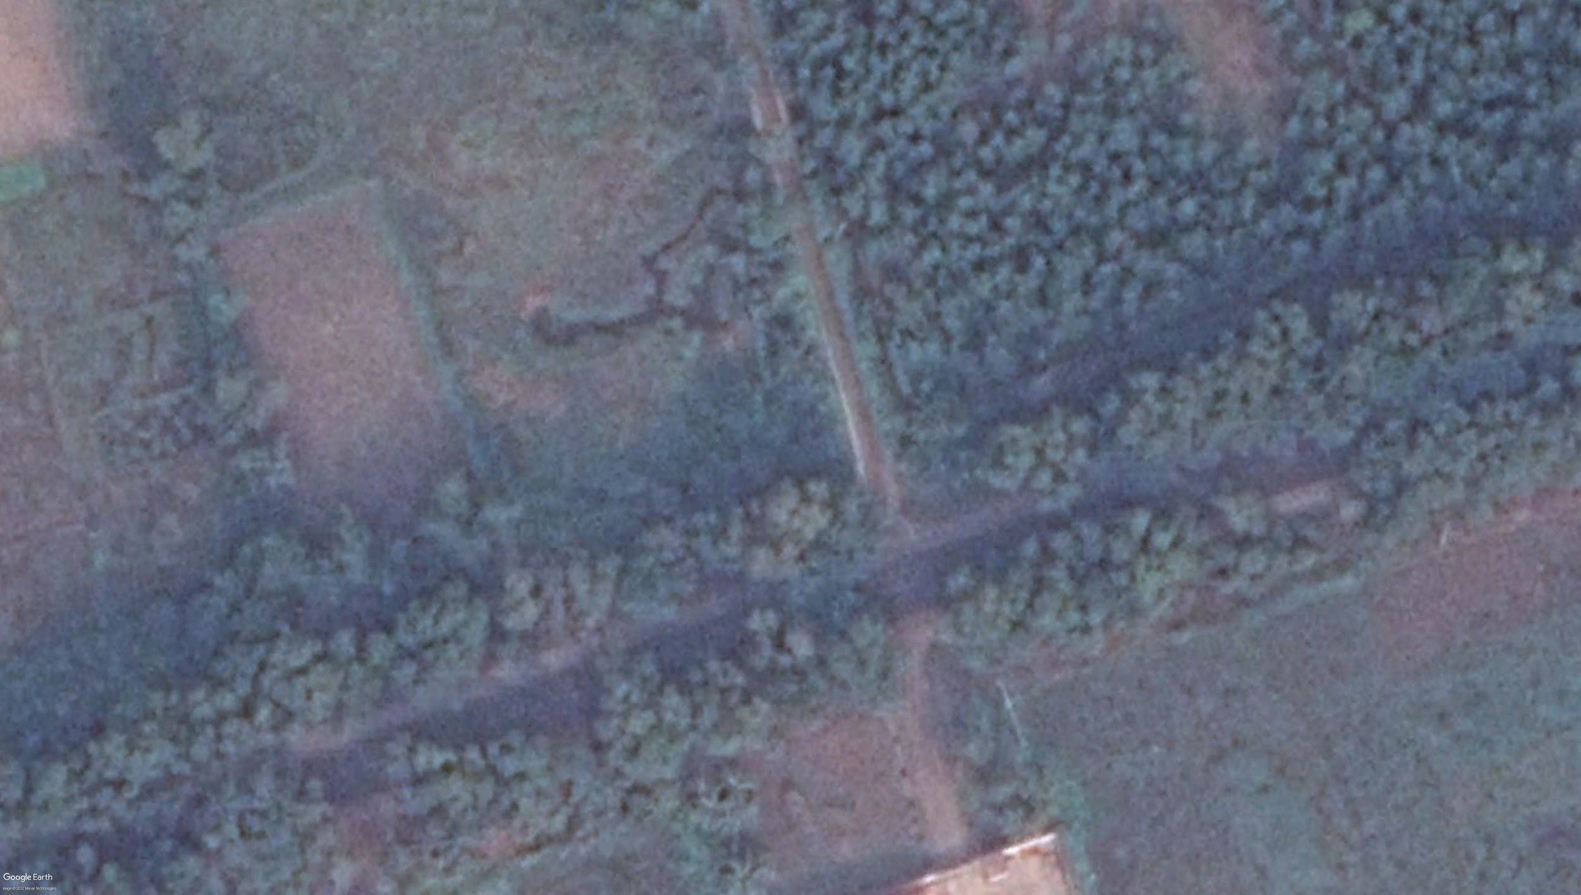
Limitations
Discarded the images manually where road segments are invisible because of traffics, trees, clouds, and other reasons. This also causes reduced dataset.
Fig : Elimination of the image data where road segment are invisible

Slide 78
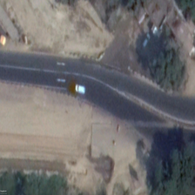
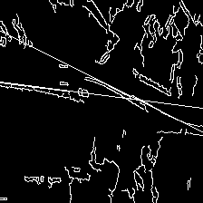
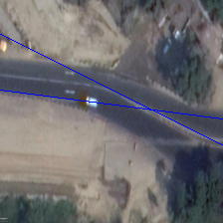
Limitations
Input Image After applying canny edge, Output Image
hough line transformation
Fig: Limitation of detecting curved road segment using Houghline technique

Slide 79
Conclusion and Future Work

Slide 80
Conclusion
We found positive correlation between predictive accuracy and the homogeneity of road.
Predictive accuracy is better in same training distribution road(standard test set).
Predictive accuracy is relatively lower in different distribution (held-out)
Bigger patch performed better than smaller patches.
Found ResNet50 perform better overall, though model choice seems to lesser important than patch dimension and train-test ratio.
More improvement is required for confident analysis of a never before seen road..
Notes:
In a conclusion our thesis work:

Slide 81
Future Work
Apply image processing and enhancement technique to remove cloud and other noises from image
Modify an algorithm for detecting straight and curved roads at a time for our task
Improve the generalization performance so that model can infer the quality of held-out road more confidently
Applying RNN: Lstms, autoencoder for learning sequences of the road instead of an individual patch.
Detection of images whose are not actually road images but detected as a road in our web based system .

Slide 82
References
[1]Roads and Highway Department of Bangladesh. (2018). Retrieved from http://www.rhd.gov.bd/RHDNews/Docs/Needs_Report_2018.pdf?fbclid=IwAR03s57wxAfEDGCRM1hbEpFW2OgrsAc9uHkp6FdW95MU8LUa_XCeh-sDesc.
[2]Cadamuro, G., Muhebwa, A., & Taneja, J. (2018). Assigning a grade: Accurate measurement of road quality using satellite imagery. arXiv preprint arXiv:1812.01699.
[3]Dorj, B., & Lee, D. J. (2016). A precise lane detection algorithm based on top view image transformation and least-square approaches. Journal of Sensors, 2016..
[4]Kumar, M., & Saxena, R. (2013). Algorithm and technique on various edge detection: A survey. Signal & Image Processing, 4(3), 65.
[5]Simonyan, K., & Zisserman, A. (2014). Very deep convolutional networks for large-scale image recognition. arXiv preprint arXiv:1409.1556.
[6]He, K., Zhang, X., Ren, S., & Sun, J. (2016). Deep residual learning for image recognition. In Proceedings of the IEEE conference on computer vision and pattern recognition (pp. 770-778).
[7]https://oldweb.lged.gov.bd/UploadedDocument/UnitPublication/4/14/2004_Road%20Design%20Standards.pdf
[8]https://oldweb.lged.gov.bd/UploadedDocument/ProjectLibraryGallery/384/2005_Road%20Design%20Standards_Rural%20Roads_Final%20(1).pdf?fbclid=IwAR0Iwo3U17JcycKonj4MPZ7zCsuFyuaB5mLipUdkuoWOVJNqdkFtufudPoQ

Slide 83
THANK YOU

